Slide 1

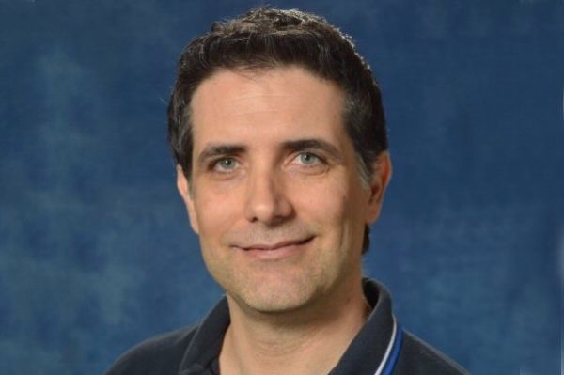


Glacier Lake Assisted Melting (GLAM)
GLAM BioLith-RT. 5 for the GMELT Toolbox
A Bio-Lithological Optical/RT Semi-Analytical Model for Water Components Concentration Retrieval and Lake Energy/Temperature Distribution Simulations
Dr. Roberto Furfaro, Professor
SIE, University of Arizona
robertof@email.arizona.edu
Enrico Schiassi, PhD Student
SIE, University of Arizona
eschiassi@email.arizona.edu
Dr. Jeffrey S. Kargel, Senior Scientist
Planetary Science Institute, Tucson, AZ
jeffreyskargel@hotmail.com

Slide 2
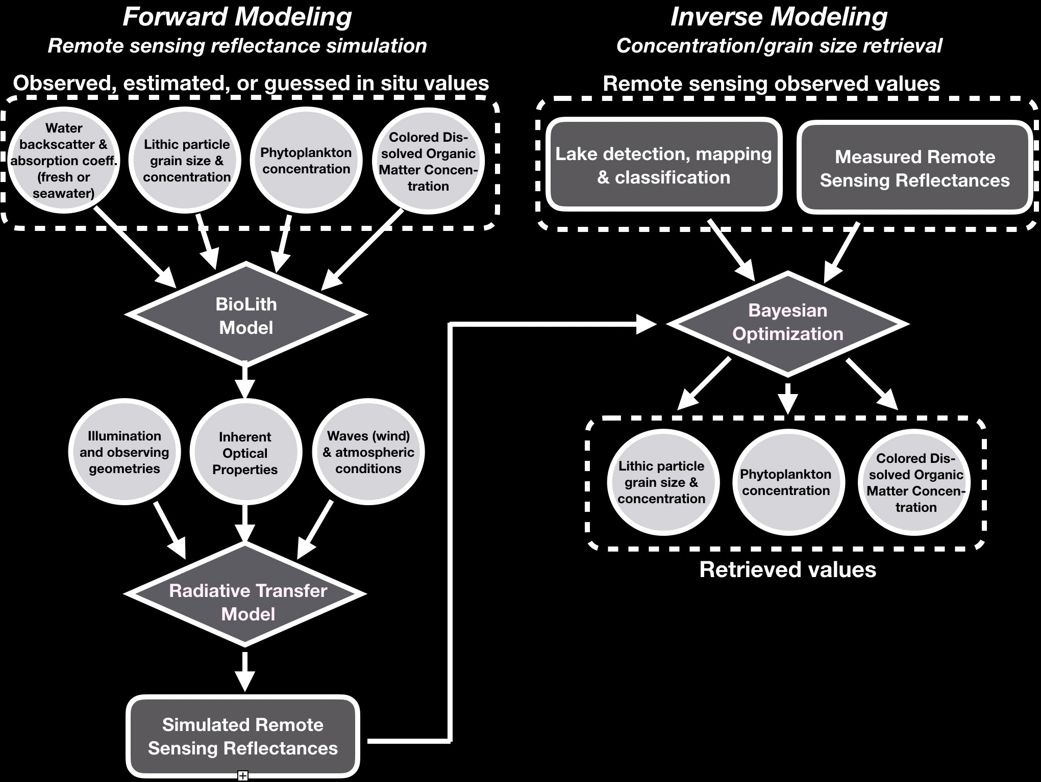
How GLAM BioLith-RT works

Slide 3
Upgrades in GLAM BioLith-RT 5
Forward modeling
slope for the CDOM absorption coefficient modeled as function on CDOM concentration according to [11] (the slope was assumed to be constant = 0.014 in the previous versions of the software [4])
SPM is now considered a real scatterers (scattering + absorption). SPM absorption coefficient is modeled according to [11]
water salinity is considered according to [4]
Inverse modeling
Bayesian optimization framework for the water components concentration and SPM grain size retrieval is now available

Slide 4
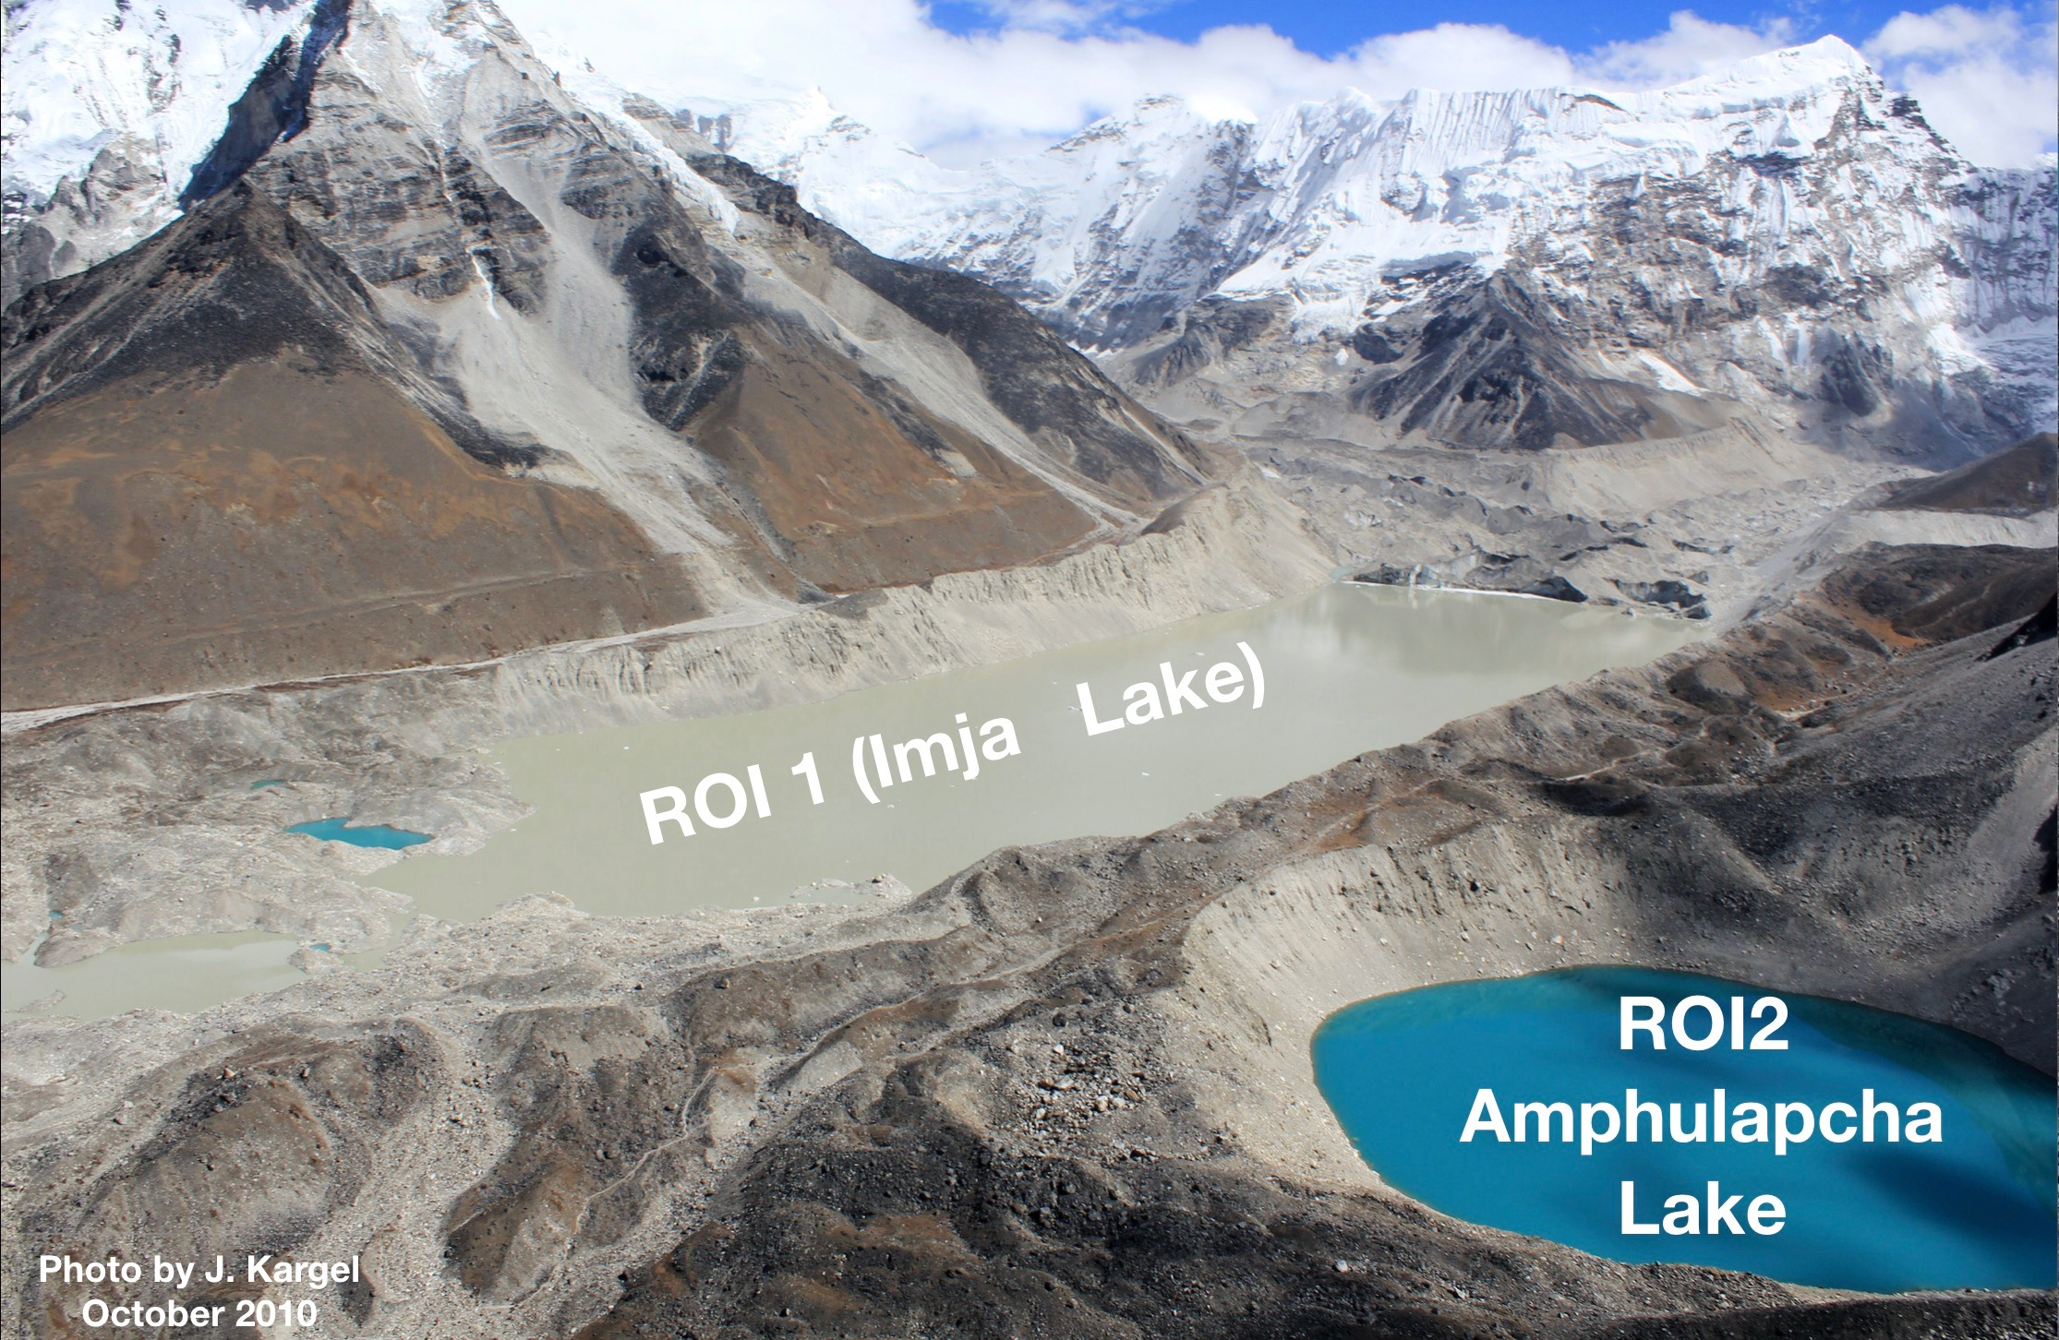
GLAM BioLith-RT 5 application for Imja Lake and Amphulapcha Lake

Slide 5
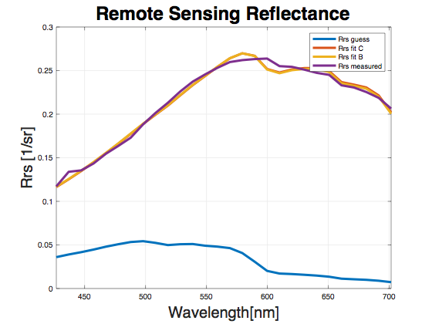
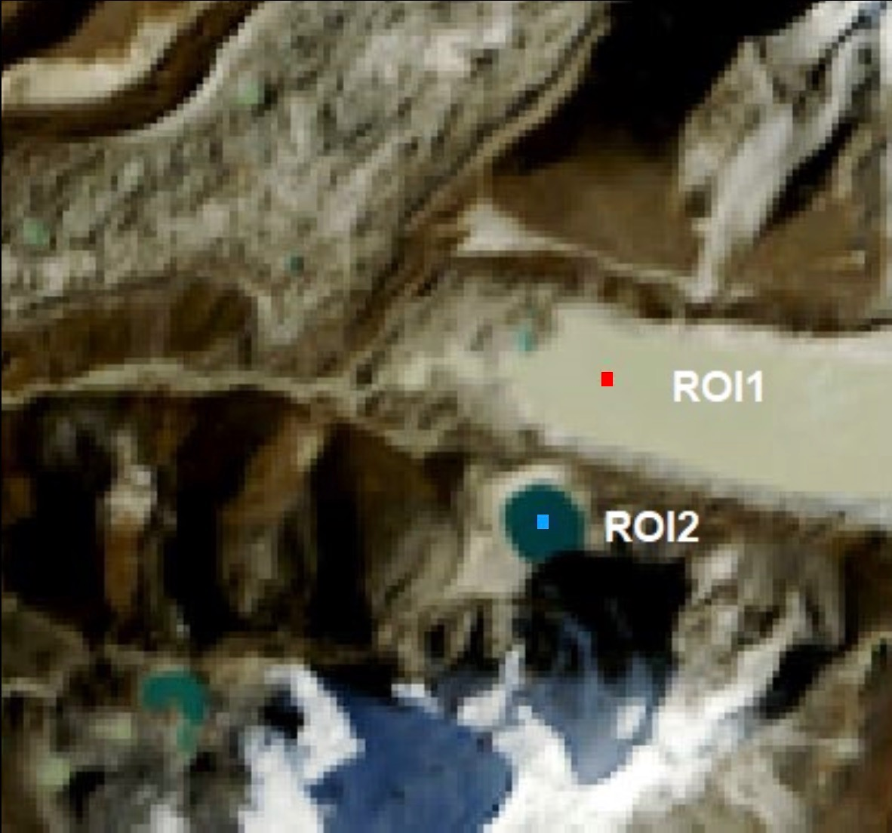
GLAM BioLith-RT 5 application for Imja Lake
Estimated values:
C_CDOM = 0.07 [mg/m^3] - tuned
C_SPM = 2.5 [g/m^3] - tuned
d_SPM = 10 [µm] - tuned
Residual = 0.9973
Retrieved value via B. opt., mean and std:
C_CDOM = 0.73214 [mg/m^3], std = 0.1377
C_SPM = 42.119 [g/m^3], std = 8.0809
d_SPM = 2.8381 [µm] , std = 5.7371e-0
Residual = 5.7204e-04

Slide 6
References
[1] Claudia Giardino, Gabriele Candiani, Mariano Bresciani, Zhongping Lee, Stefano Gagliano, Monica Pepe (2011), BOMBER: A tool for estimating water quality and bottom properties from remote sensing images, Computers & Geosciences
[2] Claudia Giardino, Mariano Bresciani, Emiliana Valentini, Luca Gasperini, Rossano Bolpagni, Vittorio E. Brando (2014) Airborne hyperspectral data to assess suspended particulate matter and aquatic vegetation in a shallow and turbid lake, Remote Sensing of Environment
[3] Peter Gege (2013) WASI-2D: A software tool for regionally optimized analysis of imaging spectrometer data from deep and shallow waters, Computers & Geosciences
[4] Peter Gege (2015) The Water Color Simulator WASI, User manual for WASI version 4.1
[5] Zhongping Lee, Kendall L. Carder, Curtis D. Mobley, Robert G. Steward, and Jennifer S. Patch (1998), Hyperspectral remote sensing for shallow waters. 1. A semianalytical modelb, Optical Society of America
[6] Zhongping Lee, Kendall L. Carder, Curtis D. Mobley, Robert G. Steward, and Jennifer S. Patch (1999), Hyperspectral remote sensing for shallow waters: 2. Deriving bottom depths and water properties , by optimization, Optical Society of America
[7] A. Albert, C.D. Mobley (2003), An analytical model for subsurface irradiance and remote sensing reflectance in deep and shallow case-2 waters, Optical Society of America
[8] Enrico Schiassi, Roberto Furfaro, and Domiziano Mostacci (2016), Bayesian inversion of coupled radiative and heat transfer models for asteroid regoliths and lakes, Radiation Effects and Defects in Solids, 171:9-10, 736-745, DOI: 10.1080/10420150.2016.1253091
[9] Paul G. Lucey (1998), Model near-infrared optical constants of olivine and pyroxene as a function of iron content, Journal of Geophysical Research, Vol. 103, No.E1, 1703-1713
[10] J. Warell, B.J.R. Davidsson (2010), A Hapke model implementation for compositional analysis of VNIR spectra of Mercury, Icarus 209 (2010), 164–178
[11] Giardino, C. Oggioni, A. Bresciani, M. and Yan, H. 2010. Remote Sensing of Suspended Particulate Matter in Himalayan Lakes. Mountain Research and Development. 30(2), 157-168. 10.1659/MRD-JOURNAL-D-09-00042.1.

